Slide 1
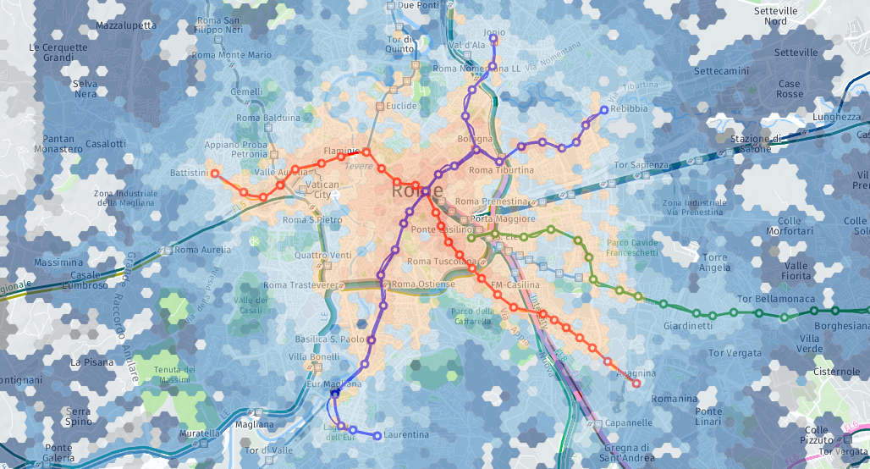
Challenges and Resources
BigDive presentation
Indaco Biazzo – www.indacobiazzo.me
Torino, 28 Giugno 2018

Slide 2
Challenges
Data analysis & Visualization
Fluxes visualizator: interactive maps visualizing fluxes of people, cars, public transports in cities.
Parkings time: estimate parkings time from data in cities.
Patterns changes: indentifing user behavioral-changes due to special events, strikes, wheaters...
WebGL visualization tools: using new uber-Lab open source library and frameworks for data visualization on maps, like deck.gl

Slide 3
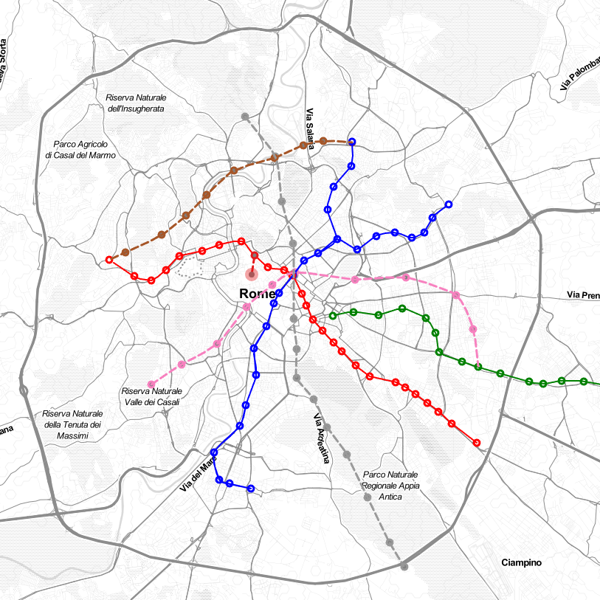
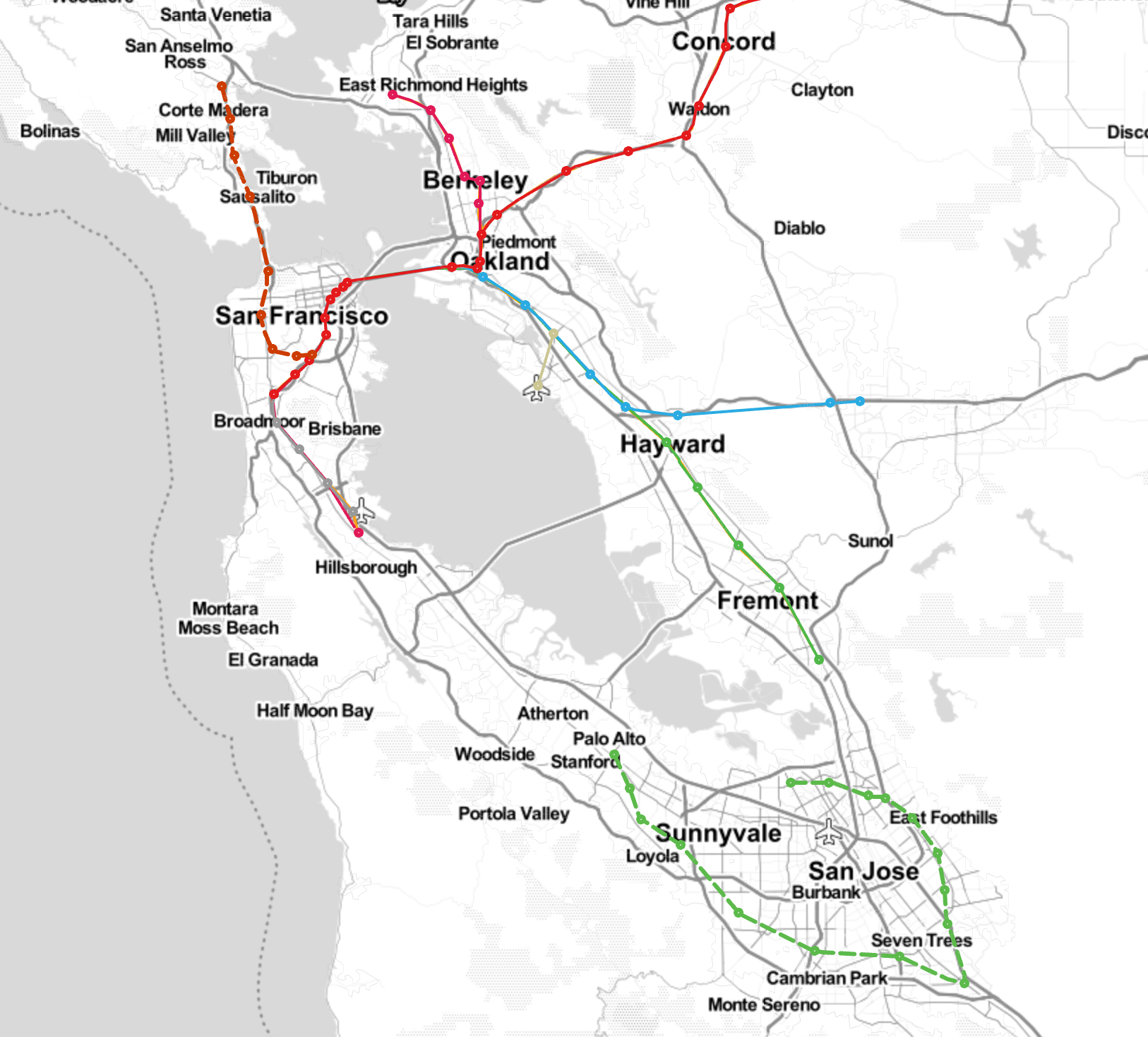
Resources
citychrone.org project: urban science studies.
https://github.com/CityChrone -- resources for studies about city transports.

Slide 4
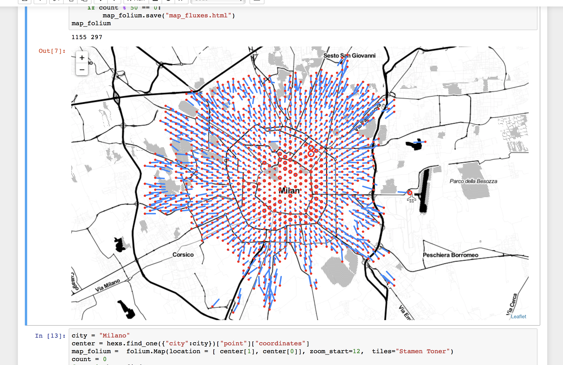
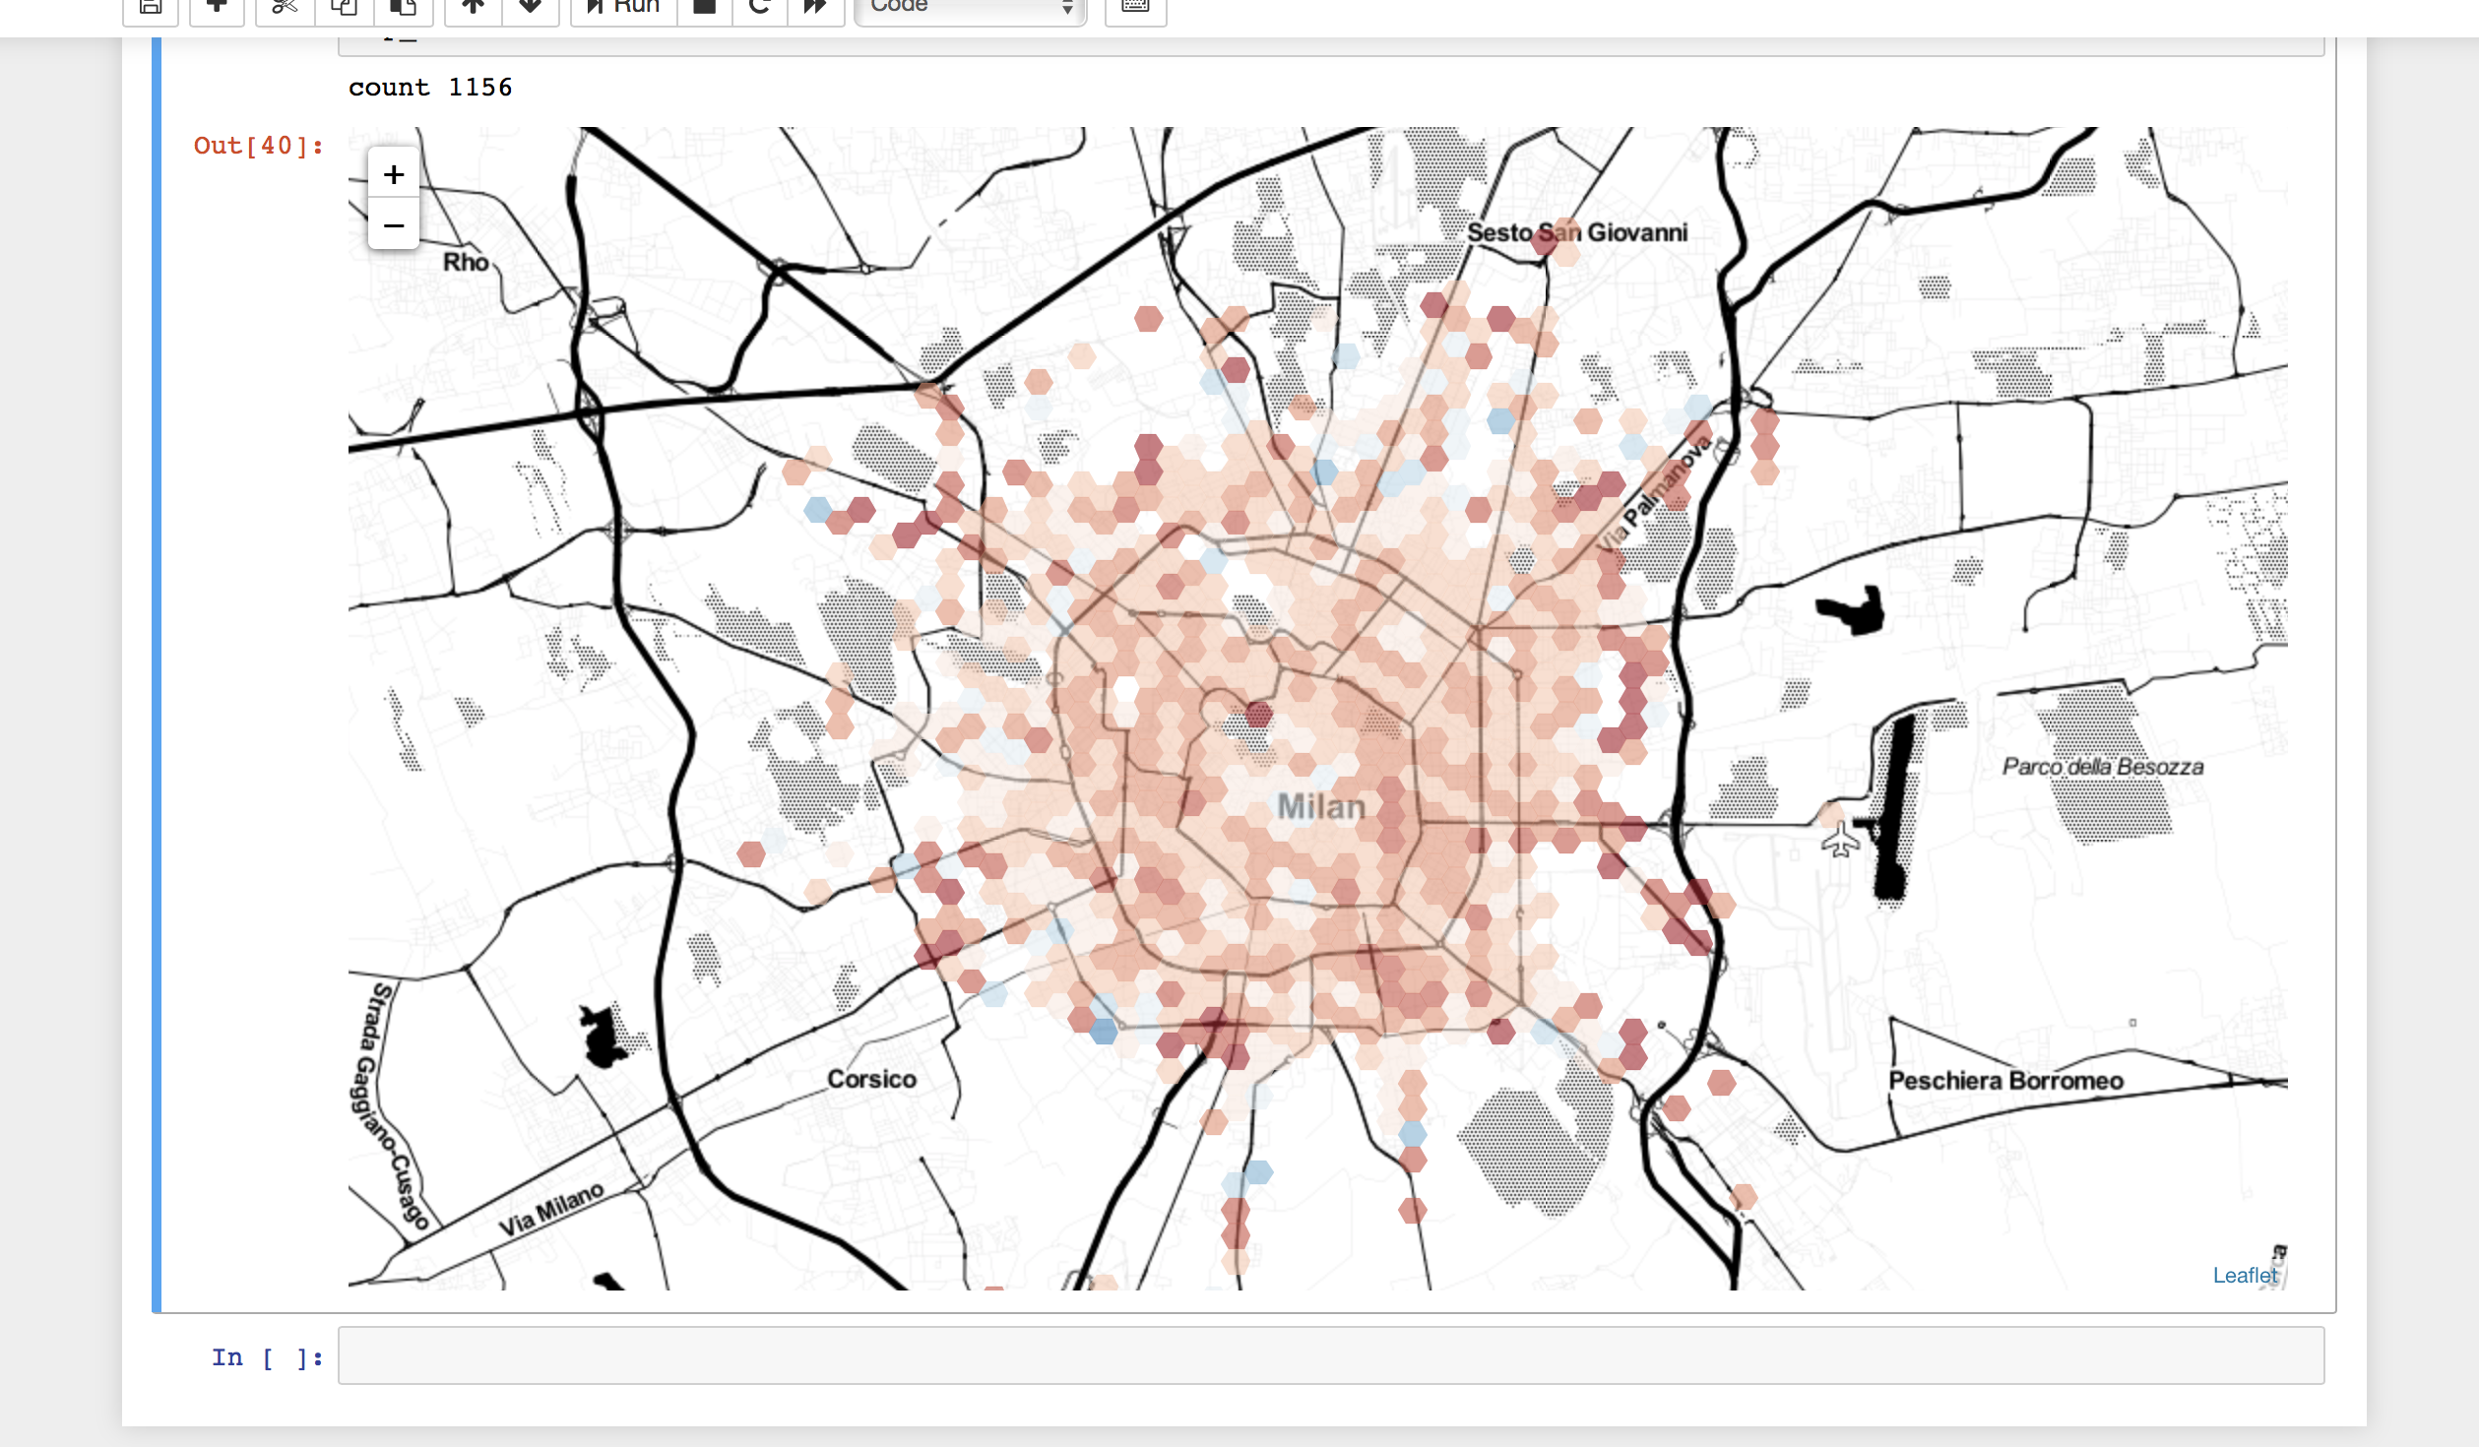
Notebooks
Github repository (citychrone/BigDive)

Slide 5
Deck.gl
wind
Hexs

Slide 6
Sharing the results
Sharing-platforms, disseminating the results.
Preparation of Medium or Authorea article for student portfolio.

